Slide 1

Capstone project
Location data and covid-19 in San francisco

Slide 2
Purpose of the project
Explore the types of different neighborhoods in San Francisco.
Explore the relationship between location data and number of COVID-19 cases.

Slide 3
Data
COVID-19 cases by zip code in San Francisco
Geo-coordinates for US zip codes
FourSquare API

Slide 4
Methodology
Merge the COVID-19 data with geo-coordinates data using the zip codes;
Use FourSquare to pull the venues close to the coordinates of the zip codes;
Perform one-hot coding for all venue types;
Save the top 10 venues for each zip code into a data frame;
Determine the optimal number of clusters using the elbow method;
Examine the number of zip codes in each cluster and cluster centroids;
Investigate the relationship between COVID-19 and clusters.

Slide 5
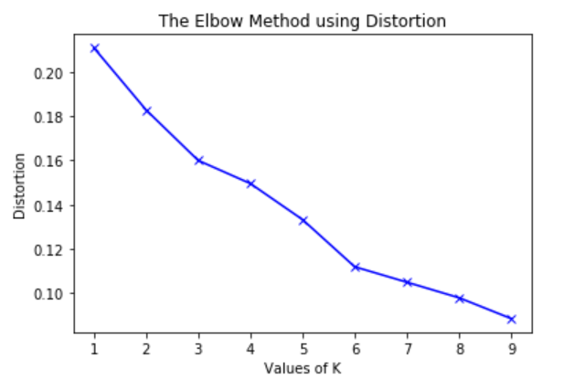
Results – Number of clusters
From the plot, it looks like the elbow point could be 3 or 6. To reserve the interpretability of the clusters, I choose to run k-means with 3 clusters.

Slide 6
Results – Cluster properties
Most zip codes fall in cluster 1. So, what are these clusters?
Cluster | Number of zip codes
0 | 1
1 | 18
2 | 2

Slide 7
Results – Cluster properties
Looks like Cluster 0 is near Chinese restaurants, dessert shop, playground, pharmacy, etc. Cluster 1 has a little bit of everything, and Cluster 2 is close to trail, garden, bus line, etc.
Cluster | Top Venues
0 | Chinese restaurants, dessert shop, playground, pharmacy, etc
1 | everything
2 | trail, garden, bus line, etc

Slide 8
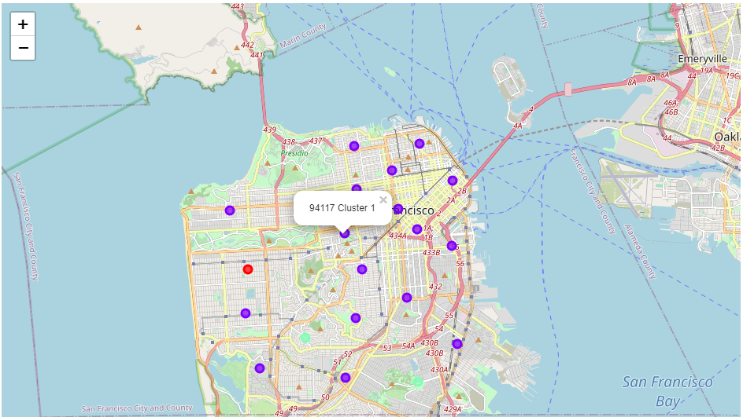
Results – clusters

Slide 9
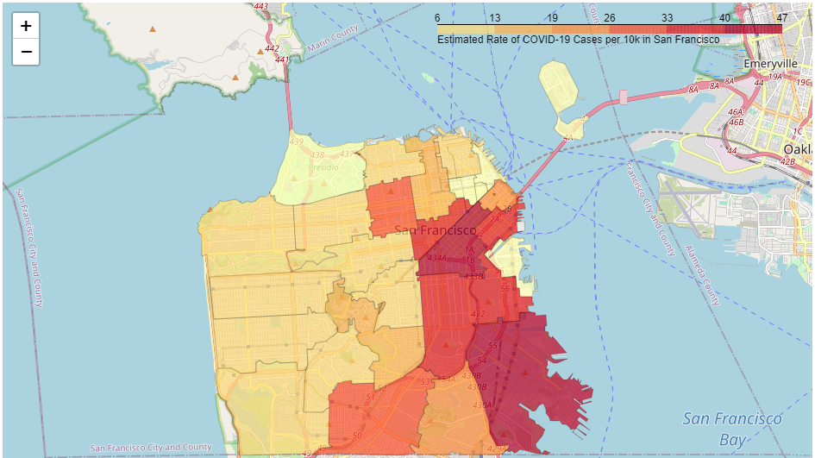
Results – covid-19 cases

Slide 10
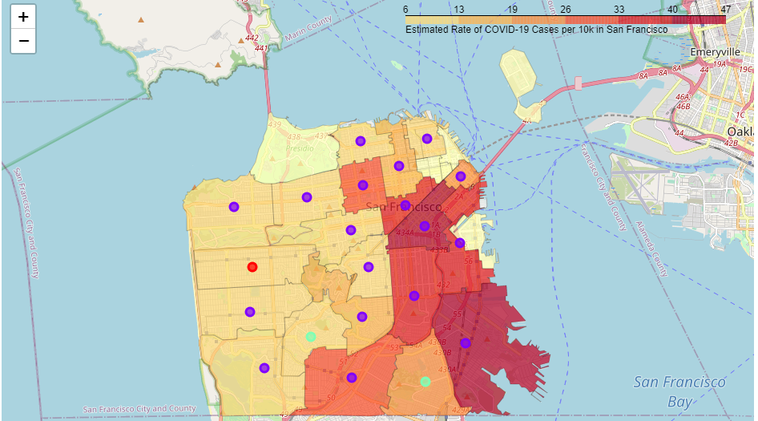
Results – clusters and covid-19

Slide 11
Discussion
Majority of zip codes in San Francisco is homogeneous. The neighborhoods in San Francisco do not have many distinctive types. Most neighborhoods have all kinds of venues around them.
It is also possible that the distinctive types of neighborhoods actually exist, but they are smaller than what a zip code covers.

Slide 12
Discussion
Exploring the zip codes and estimated rate of COVID-19 cases per 10k reveals that the relationship between the two might be very weak.
From the map, it can be seen that there are more COVID-19 cases in the east side of San Francisco. However, there is no clear evidence that more cases are necessarily related to the zip code, or the venues around the area.
It is likely that other factors might be associated with the high number of COVID-19 cases, such as population density. Further research is needed to provide evidence regarding other factors.

